Slide 1
실습 1 – Image Classification
- Image Classification
- MLP – MNIST Classification
- CNN – CIFAR-10 Classification

Slide 2
Image Classification

Slide 3

What is Image Classification?
이미지를 입력으로 받아 여러 클래스 중 하나로 분류하는 것
input
output
Black Box
“Cat”
이미지
클래스

Slide 4
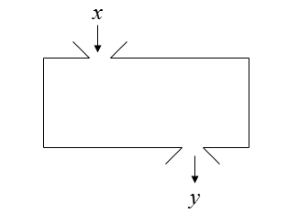
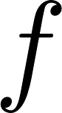
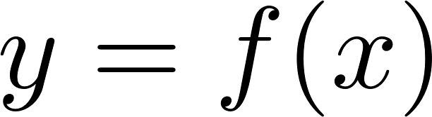
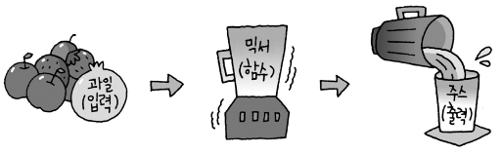
What is Input/Output?
입력: 시스템/ 프로그램에게 정보나 데이터를 제공하는 과정 혹은 그 자체
출력: 시스템/ 프로그램이 처리한 결과를 제공하는 과정 혹은 그 자체
입력
출력
[주스 믹서의 입출력]

Slide 5
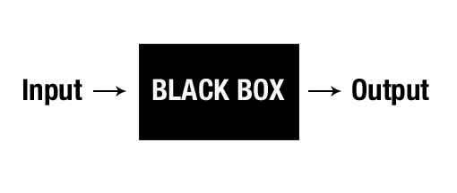
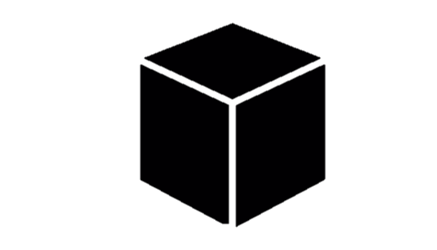
Black-box approach
영상, 비디오, 음성 모두 벡터(숫자들의 어레이)로 표현할 수 있음
출력도 벡터로 표현할 수 있음. (고양이:[1,0], 개:[0,1], …)
관찰된 숫자들이 들어가서 원하는 숫자들이 나오도록 하는 검은 상자
검은 상자는 다양한 방식으로 구현될 수 있지만 현재는 신경망이 선호됨
관계식에 필요한 파라미터는 예시(학습/훈련 데이터)로부터 결정됨 (training 과정)

Slide 6
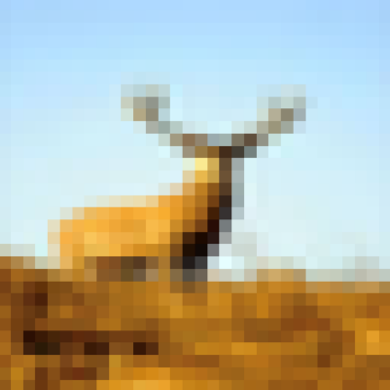
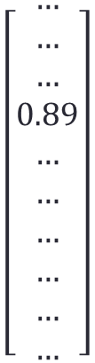

Goal of Image Classification by NN
인공신경망을 이용하여 어떻게 이미지를 분류할 수 있을까?
input
Black Box
output
$$\left[\begin{aligned}… \\ … \\ … \\ 0.89 \\ … \\ … \\ … \\ … \\ … \\ …\end{aligned}\right]$$
$$\left[\begin{aligned}비행기 \\ 자동차 \\ 새 \\ 사슴 \\ 고양이 \\ 강아지 \\ 개구리 \\ 말 \\ 배 \\ 트럭\end{aligned}\right]$$
NN Image Classifier
= “deer”

Slide 7
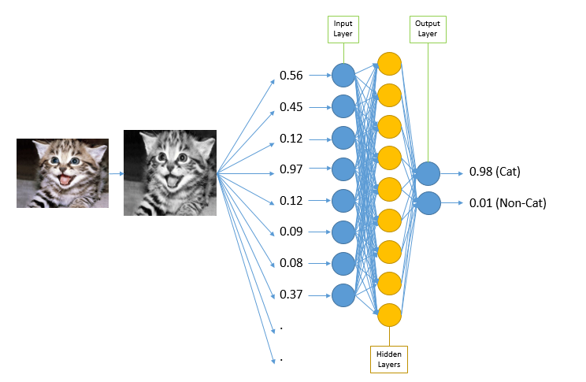
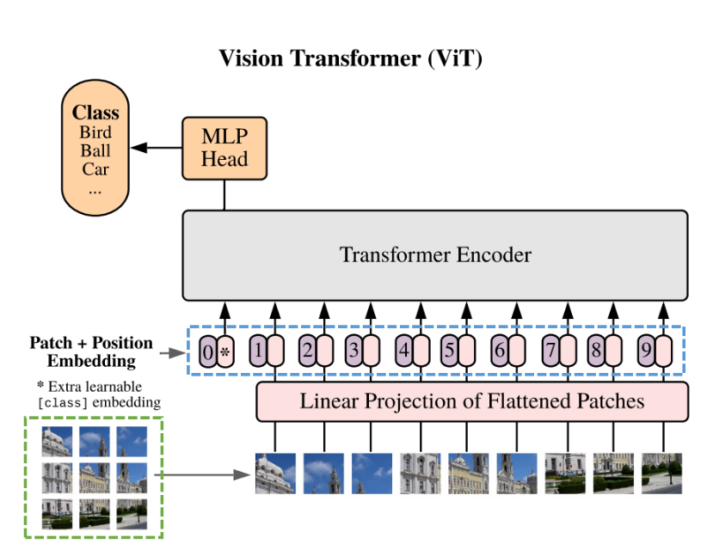

이미지 분류를 위한 다양한 인공신경망
We can use …
MLP(Multi-Layer Perceptron)
CNN(Convolutional Neural Network)
Transformer
…

Slide 8
Linear perceptron

Slide 9
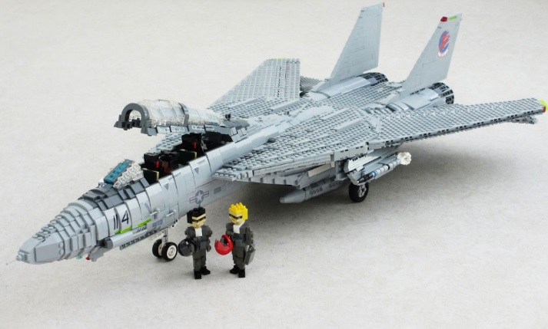
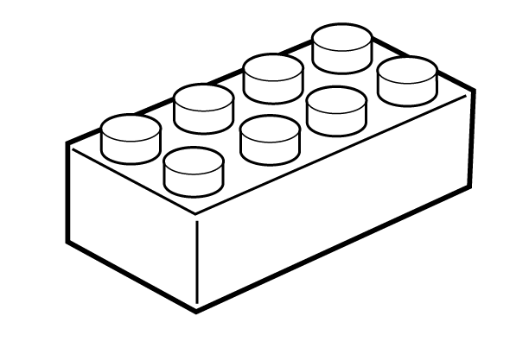
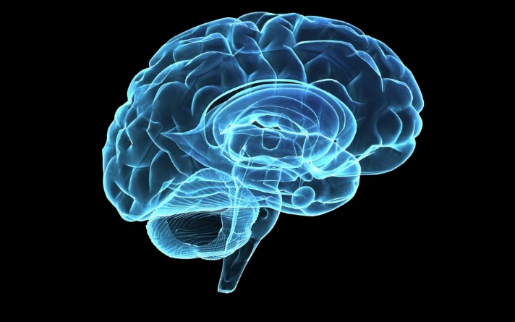
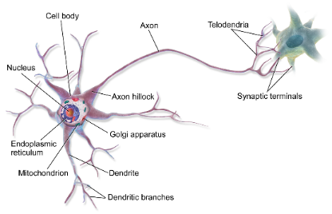
뉴런: 신경망의 기본 단위
레고
비행기 모형
신경세포
뇌

Slide 10
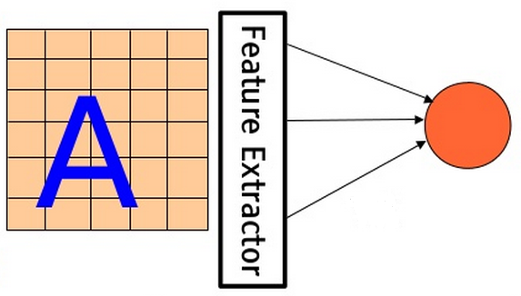
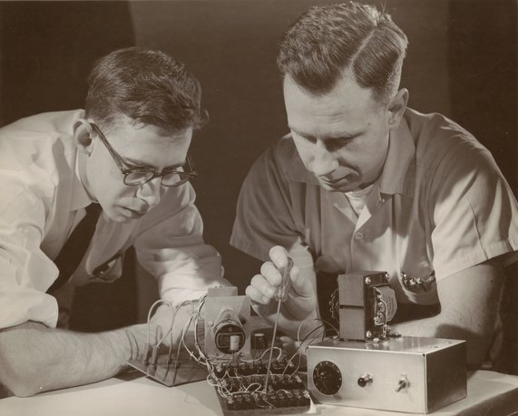
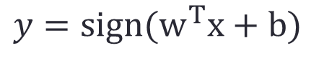
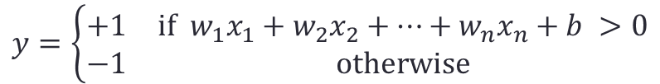
Basic model
The first learning machine: the Perceptron (built in 1960)
The perceptron was a linear classifier
$$y=sign(w^{T}x+b)$$
$$y=\left\{\begin{matrix}+1 & if w_{1}x_{1}+w_{2}x_{2}+⋯+w_{n}x_{n}+b >0 \\ −1 & otherwise\end{matrix}\right.$$
기사 인공 신경망의 첫 구현체이자 현대 딥러닝의 시초, 퍼셉트론 https://magazine.hankyung.com/business/article/202103186579b

Slide 11
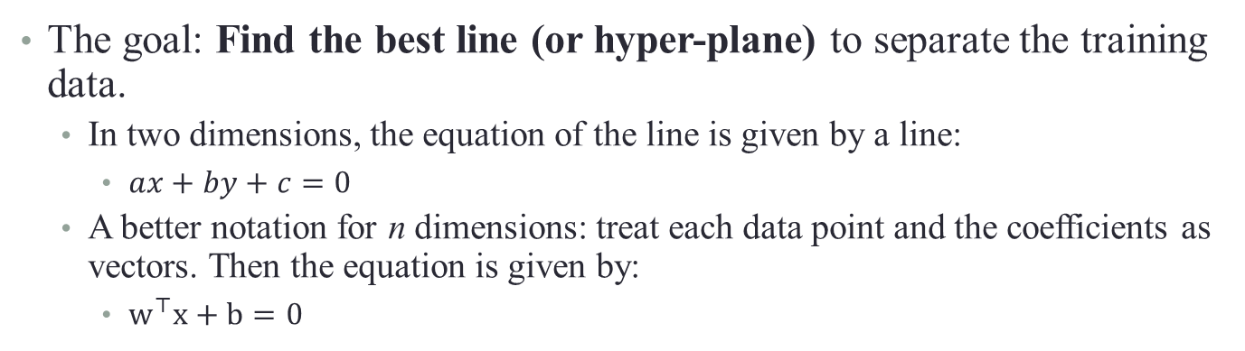
Linear Perceptron
Class (-1)
Class (+1)
The goal: Find the best line (or hyper-plane) to separate the training data.
In two dimensions, the equation of the line is given by a line:
$ax+by+c=0$
A better notation for n dimensions: treat each data point and the coefficients as vectors. Then the equation is given by:
$w^{⊤}x+b=0$

Slide 12
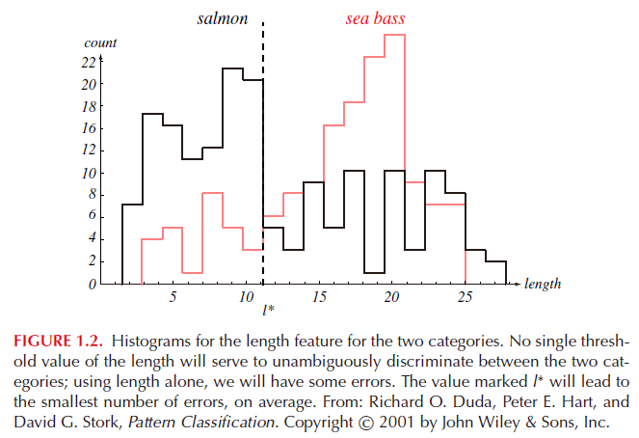
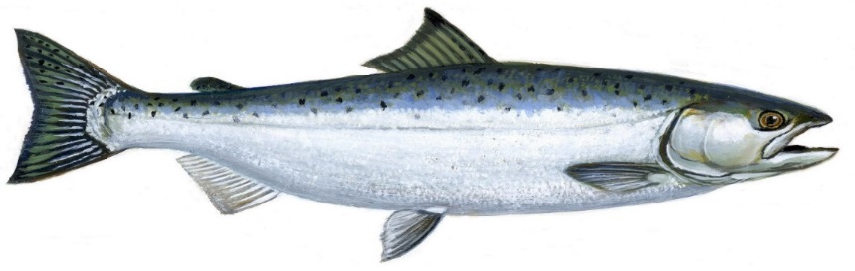
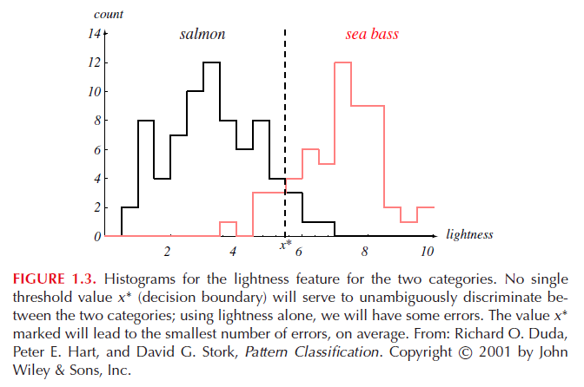
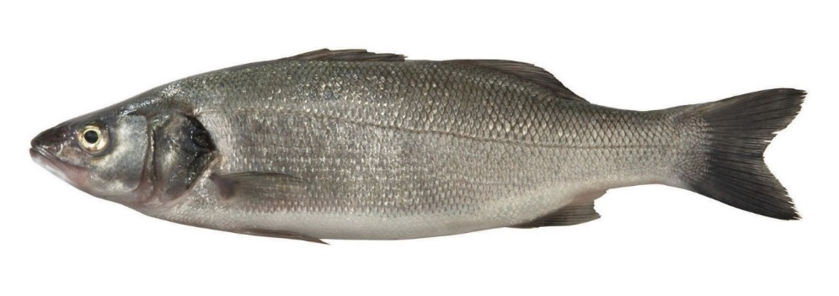
예시: 연어와 농어의 구별

Slide 13
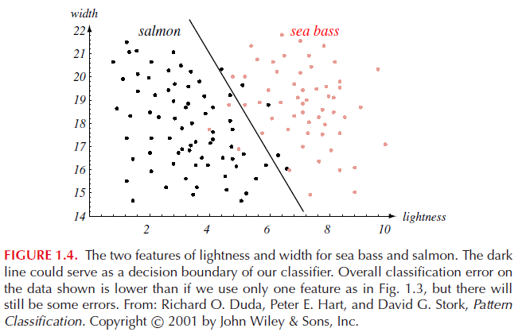


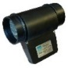
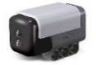
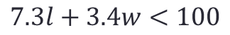
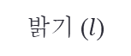
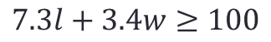

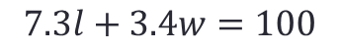
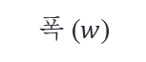
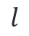
예시: 연어와 농어의 구별
폭 ($w$)
$$7.3l+3.4w=100$$
밝기 ($l$)
$$l$$
농어
$$7.3l+3.4w≥100$$
$$w$$
연어
$$7.3l+3.4w<100$$

Slide 14
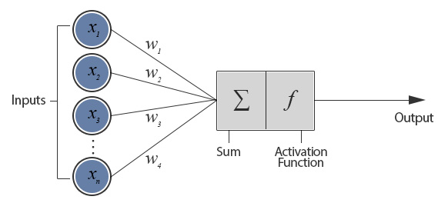
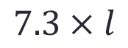


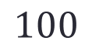

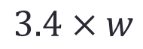
예시: 연어와 농어의 구별
$$l$$
$$7.3×l$$
$$Σ$$
연어/농어
$$w$$
$$3.4×w$$
$$100$$

Slide 15
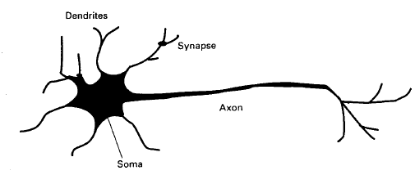
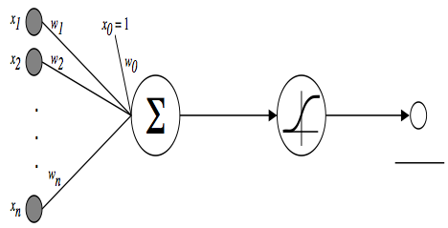
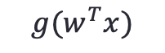
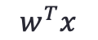
Artificial Neuron
$$w^{T}x$$
$${g(w}^{T}x)$$
Activation function (non-linear)

Slide 16
Artificial Neuron
However, it cannot solve non-linearly-separable problems
Line 1
Line 2
Line 3
Line 4

Slide 17
Multi-layer perceptron

Slide 18
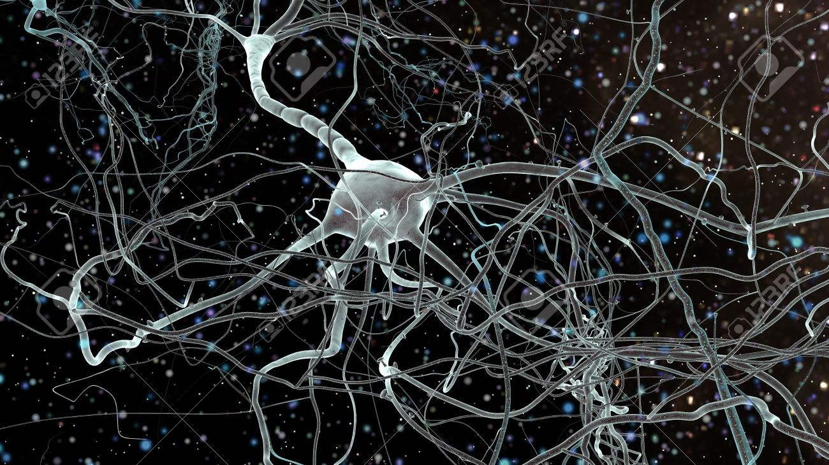
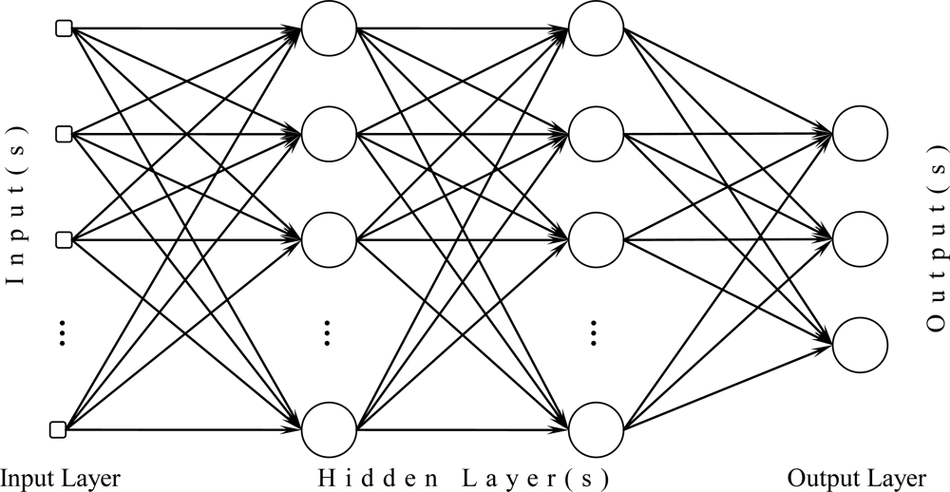

Slide 19

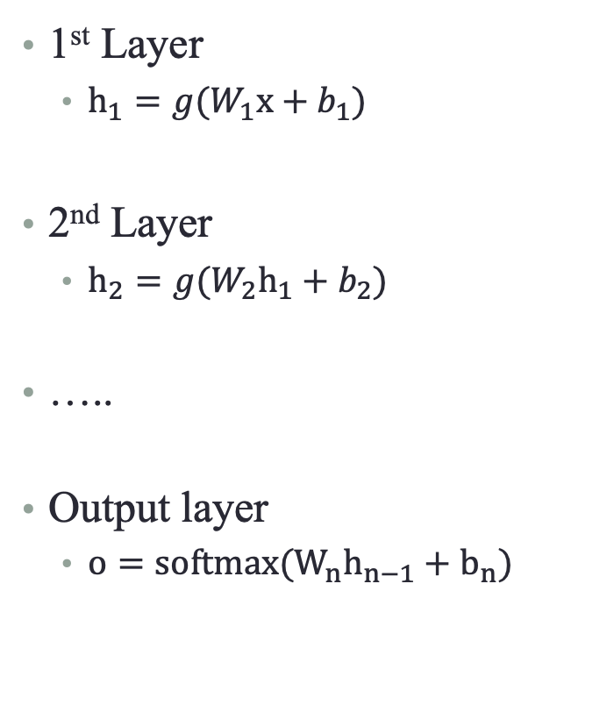

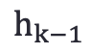
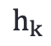
Multi-layer Neural Network
1st Layer
$h_{1}=g(W_{1}x+b_{1})$
2nd Layer
$h_{2}=g(W_{2}h_{1}+b_{2})$
…..
Output layer
$o=softmax(W_{n}h_{n−1}+b_{n})$
$$=$$
$$h_{k}$$
$$W_{k}$$
$$h_{k−1}$$

Slide 20
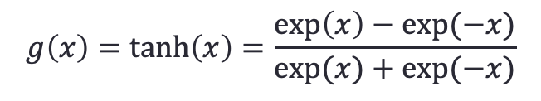
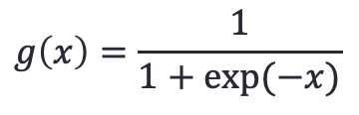

Activation function $g(⋅)$
Sigmoid activation function
Squashes the neuron’s pre-activation between 0 and 1
Always positive/Bounded/Strictly increasing
Hyperbolic tangent (‘‘tanh’’) activation function
Squashes the neuron’s pre-activation between -1 and 1
Bounded/Strictly increasing
$$g\left(x\right)=\frac{1}{1+exp⁡(−x)}$$
$$g\left(x\right)=\tanh\left(x\right)=\frac{\exp\left(x\right)−exp⁡(−x)}{exp⁡(x)+exp⁡(−x)}$$

Slide 21
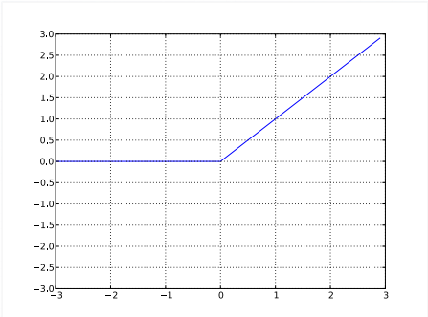
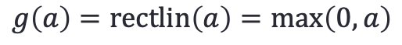
Activation function $g(⋅)$
Rectified linear activation function (ReLU)
Bounded below by 0
Not upper bounded
Strictly increasing
$$g\left(a\right)=rectlin\left(a\right)=\max\left(0,a\right)$$

Slide 22
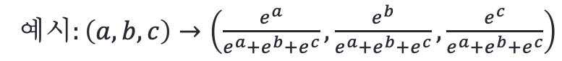

Soft-max activation function at the output
For multi-class classification
We need multiple outputs (1 output per class)
We use the softmax activation function at the output
strictly positive
sums to one
$$O\left(a\right)=softmax\left(a\right)=\left[\begin{matrix}\begin{aligned}\frac{\exp\left(a_{1}\right)}{\sum_{c}{\exp\left(a_{c}\right)}} \\ \frac{\exp\left(a_{2}\right)}{\sum_{c}{\exp\left(a_{c}\right)}}\end{aligned} \\ \begin{aligned}⋮ \\ ⋮\end{aligned} \\ \frac{\exp\left(a_{c}\right)}{\sum_{c}{\exp\left(a_{c}\right)}}\end{matrix}\right]$$
예$시:\left(a,b,c\right)→\left(\frac{e^{a}}{e^{a}+e^{b}+e^{c}},\frac{e^{b}}{e^{a}+e^{b}+e^{c}},\frac{e^{c}}{e^{a}+e^{b}+e^{c}}\right)$

Slide 23











Example (character recognition example)
softmax
$$p(c="0"|x)$$
$$p(c="1"|x)$$
$$⋮$$
140 inputs
$$p(c="9"|x)$$
$$x∈{\left\{0,1\right\}}^{10×14}$$
Layer 1 with 12 perceptrons
Layer 2 with 10 perceptrons
Each having 12 inputs
$$W_{1}∈ℜ^{12×140}$$
$$W_{2}∈ℜ^{10×12}$$
$$b_{1}∈ℜ^{12}$$
$$b_{2}∈ℜ^{10}$$

Slide 24


Example (character recognition example)
3 - Layer MLP
본 프로젝트에서는 은닉층 2개, 출력층 1개로 구성된 3-Layer MLP를 구성하여 Handwritten Digit Recognition을 수행한다.
140 inputs
$$x∈{\left\{0,1\right\}}^{10×14}$$
Input Layer
Hidden Layer
Output Layer

Slide 25
Example (character recognition example)
Input Layer
Hidden Layer
Output Layer
0.0 | 0.99 | 0.0
0.0 | 0.99 | 0.0
0.0 | 0.89 | 0.0
0 : 0.01 1 : 0.99 •
•
•
8 : 0.00
9 : 0.08
28x28 숫자 데이터
예측 결과

Slide 26
Training of Multi-layer perceptron

Slide 27


How do we train a neural network?
인공신경망을 어떻게 훈련(학습)시킬 수 있을까요?
How do we ‘train’ neural networks? https://towardsdatascience.com/how-do-we-train-neural-networks-edd985562b73

Slide 28


Training: Loss function
Error
Cross entropy (classification)
$y,\hat{y}∈{\left[0,1\right]}^{N},\sum_{i=1}{y_{i}}=1,\sum_{i=1}{{\hat{y}}_{i}}=1$
$L=−∑y_{i}log{\hat{y}}_{i}$
Square Euclidean distance (regression)
$y,\hat{y}∈ℜ^{N}$
$L=\frac{1}{2}∑{\left(y_{i}−\hat{y_{i}}\right)}^{2}$

Slide 29


Cross Entropy (예시)
Label:
$[y_{1} y_{2} y_{3}]$= [1,0,0] : class 1
$[y_{1} y_{2} y_{3}]$ = [0,1,0] : class 2
$[y_{1} y_{2} y_{3}]$ = [0,0,1] : class 3
예시
Network output: $\hat{y} =[{\hat{y}}_{1} {\hat{y}}_{2} {\hat{y}}_{3} ]= [0.3, 0.6, 0.1]$
Loss
If ground truth is class 1 (i.e., y = [1,0,0]) $→−log 0.3=1.20$4
If ground truth is class 2 (i.e., y = [0,1,0]) $→−log 0.6=0.511$
If ground truth is class 3 (i.e., y = [0,0,1]) $→−log 0.1=2.30$3
Network output:$\hat{y}$ $=[{\hat{y}}_{1} {\hat{y}}_{2} {\hat{y}}_{3} ]$= [0.01, 0.98, 0.01]
Loss
If ground truth is class 1 (i.e., y = [1,0,0]) $→−log 0.01=4.605$
If ground truth is class 2 (i.e., y = [0,1,0]) $→−log 0.98=0.020$
If ground truth is class 3 (i.e., y = [0,0,1]) $→−log 0.01=4.605$
$$L=−∑y_{i}log{\hat{y}}_{i}$$

Slide 30

Cross entropy (예시)
 | If ground truth is class 1 (i.e., y = [1,0,0]) | If ground truth is class 2 (i.e., y = [0,1,0]) | If ground truth is class 3 (i.e., y = [0,0,1])
$$[{\hat{y}}_{1} {\hat{y}}_{2} {\hat{y}}_{3} ]= [0.3, 0.6, 0.1]$$ | $−log 0.3=1.20$4 | $−log 0.6=0.511$ | $−log 0.1=2.30$3
$$[{\hat{y}}_{1} {\hat{y}}_{2} {\hat{y}}_{3} ]$$ = [0.01, 0.98, 0.01] | $−log 0.01=4.605$ | $$−log 0.98=0.020$$ | $$−log 0.01=4.605$$

Slide 31


Forward/Backward propagation
Chain rule
$$W^{new }=W^{old}−η\frac{dL}{dW}$$

Slide 32





Slide 33




Slide 34












Forward/Backward propagation
$$x$$
$$y=g(Wx+b)$$
$$y$$
$$W$$
$$\frac{∂L}{∂x}=\frac{∂L}{∂y}⋅\frac{∂y}{∂x}$$
Forward propagation
$$\frac{∂L}{∂x}$$
$$\frac{∂y}{∂x}$$
$$\frac{∂y}{∂W}$$
$$\frac{∂L}{∂y}$$
$\frac{∂L}{∂W}$=$\frac{∂L}{∂y}\frac{∂y}{∂W}$
Backward propagation

Slide 35
Feed-forward neural network

Slide 36









Forward propagation
Soft Max
Layer 1
Layer 2
Output
Notes:
\begin{bmatrix}
\frac{e^{z_1}}{e^{z_1} + e^{z_2}}
\\
\\
\frac{e^{z_2}}{e^{z_1} + e^{z_2}}
\end{bmatrix}

Slide 37


Forward propagation matrix repr.
Soft Max
Layer 1
Layer 2
Output
Notes:
\begin{equation}
\begin{bmatrix} y_1\\y_2\\y_3\end{bmatrix}
=\varphi\Bigg(
\begin{bmatrix}
w_{11}&w_{12}&b_1\\
w_{21}&w_{22}&b_2\\
w_{31}&w_{32}&b_3
\end{bmatrix}
\begin{bmatrix}
x_1\\
x_2\\
1
\end{bmatrix}
\Bigg)
\end{equation}
\begin{equation}
\begin{bmatrix}
z_1\\z_2
\end{bmatrix}
=\varphi\Bigg(
\begin{bmatrix}
u_{11}&w_{12}&u_{13}&c_1\\
u_{21}&w_{22}&u_{23}&c_2
\end{bmatrix}
\begin{bmatrix}
y_1\\
y_2\\
y_3\\
1
\end{bmatrix}
\Bigg)
\end{equation}

Slide 38
Ex 1. PyTorch MNIST Classification
Multi-layer Perceptron

Slide 39

The ideal machine learning pipeline

Slide 40
Handwritten Digit Recognition project
MNIST classification using MLP - PyTorch

Slide 41


MNIST
Dataset consists of 70,000 28x28 images in 10 classes of digit
60,000 training images and 10,000 test images.
large database of handwritten digits

Slide 42


Goal
MLP classifier
input
output
$$\left[\begin{aligned}0.01 \\ 0.91 \\ 0.01 \\ 0.01 \\ 0.01 \\ 0.01 \\ 0.01 \\ 0.01 \\ 0.01 \\ 0.01\end{aligned}\right]$$
= “1”

Slide 43




SW 개발 환경 구성
Google Colab
구글 로그인 및 링크 Colab 사이트 접속
노트열기 – 다운로드한 .ipynb 파일 실행
상단 런타임 – 런타임 유형 변경 – 하드웨어 가속기 GPU 설정

Slide 44



Framework
Frame + Work = Framework
응용프로그램을 개발하기 위한 여러 라이브러리, 모듈 등을 하나로 묶은 패키지
개발에 필요한 시간 및 비용을 절약
Deep learning Framework
검증된 수많은 라이브러리, 알고리즘, 데이터셋을 제공
TensorFlow, Pytorch, Keras, etc.

Slide 45
To do
MNIST Classification
Configure development environment.
Prepare and Preprocess datasets.
Architecture design
Loss and Optimization option setting
Training
Validation
Evaluation
…

Slide 46

Prepare & Preprocess datasets
Prepare and Preprocess CIFAR-10 datasets.
Architecture design
Loss and Optimization option setting
Training
MNIST 데이터셋 준비
PyTorch에서 MNIST 데이터셋을 불러오기 위해 datasets.MNIST()를 사용
‘train’옵션을 이용하여 test 데이터셋과 train 데이터셋 구분하여 저장(train=True이면 train set, False이면 test set)
‘transform’옵션을 이용해 데이터를 텐서 형태로 변환, 각 픽셀을 0~1 사이의 값으로 정규화

Slide 47


Visualize datasets
Prepare and Preprocess CIFAR-10 datasets.
Architecture design
Loss and Optimization option setting
Training
데이터 시각화를 통해 데이터 검증

Slide 48

Architecture design(Choice)
[Multi-layer perceptron]
[Convolutional Neural Network]
Prepare and Preprocess CIFAR-10 datasets.
Architecture design
Loss and Optimization option setting
Training
Validation
Evaluation
…

Slide 49


Architecture design(Choice)
[Multi-layer perceptron]
Prepare and Preprocess CIFAR-10 datasets.
Architecture design
Loss and Optimization option setting
Training
Validation
Evaluation
…

Slide 50

Loss, Optimization
Prepare and Preprocess CIFAR-10 datasets.
Architecture design
Loss and Optimization option setting
Training
Validation
Evaluation
…
Loss:
Cross entropy
Optimizer:
Adam
Hyper parameter:
Learning rate : 0.005

Slide 51

Training
Prepare and Preprocess CIFAR-10 datasets.
Architecture design
Loss and Optimization option setting
Training
Validation
Evaluation
…

Slide 52

Validation
Prepare and Preprocess CIFAR-10 datasets.
Architecture design
Loss and Optimization option setting
Training
Validation
Evaluation
…

Slide 53


Evaluation
[Multi-layer perceptron]
Prepare and Preprocess CIFAR-10 datasets.
Architecture design
Loss and Optimization option setting
Training
Validation
Evaluation
…

Slide 54


Inference

Slide 55

How to use?

Slide 56
The ideal machine learning pipeline

Slide 57
Ex 2. PyTorch CIFAR-10 Classification

Slide 58
CIFAR-10 Classification

Slide 59

CIFAR-10
Dataset consists of 60000 32x32 color images in 10 classes
6000 images per class, 50000 training images and 10000 test images.
The classes are completely mutually exclusive.
[Class 0]
[Class 1]
[Class 2]
[Class 3]
[Class 4]
[Class 5]
[Class 6]
[Class 7]
[Class 8]
[Class 9]

Slide 60

Goal
input
output
$$\left[\begin{aligned}0.01 \\ 0.01 \\ 0.10 \\ 0.89 \\ 0.01 \\ 0.01 \\ 0.01 \\ … \\ … \\ …\end{aligned}\right]$$
NN Image Classification
= “deer”
32x32x3

Slide 61
To do
CIFAR-10 PyTorch Classification
Prepare and Preprocess datasets.
Architecture design
Loss and Optimization option setting
Training
Validation
Evaluation
…

Slide 62


Prepare & Preprocess datasets
Prepare and Preprocess CIFAR-10 datasets.
Architecture design
Loss and Optimization option setting
Training
Validation
Evaluation
…

Slide 63
Architecture design(Choice)
[Multi-layer perceptron]
[Convolutional Neural Network]
Prepare and Preprocess CIFAR-10 datasets.
Architecture design
Loss and Optimization option setting
Training
Validation
Evaluation
…

Slide 64


Architecture design(Choice)
[Multi-layer perceptron]
[Convolutional Neural Network]
Prepare and Preprocess CIFAR-10 datasets.
Architecture design
Loss and Optimization option setting
Training
Validation
Evaluation
…

Slide 65


Designed model
[Multi-layer perceptron]
[Convolutional Neural Network]
Prepare and Preprocess CIFAR-10 datasets.
Architecture design
Loss and Optimization option setting
Training
Validation
Evaluation
…

Slide 66

Loss, Optimization
Prepare and Preprocess CIFAR-10 datasets.
Architecture design
Loss and Optimization option setting
Training
Validation
Evaluation
…

Slide 67

Training
Prepare and Preprocess CIFAR-10 datasets.
Architecture design
Loss and Optimization option setting
Training
Validation
Evaluation
…

Slide 68

Validation
Prepare and Preprocess CIFAR-10 datasets.
Architecture design
Loss and Optimization option setting
Training
Validation
Evaluation
…

Slide 69



Evaluation
[Multi-layer perceptron]
[Convolutional Neural Network]
Prepare and Preprocess CIFAR-10 datasets.
Architecture design
Loss and Optimization option setting
Training
Validation
Evaluation
…

Slide 70


Inference

Slide 71
The ideal machine learning pipeline

